Slide 1
Project: tDisk
What, How,

Slide 2
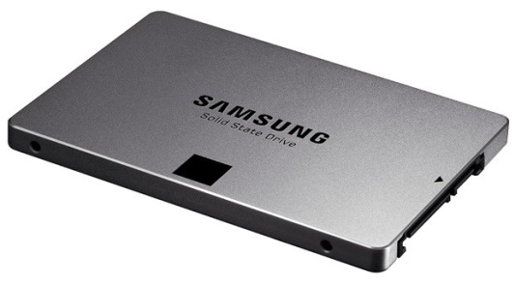
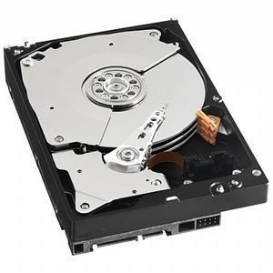
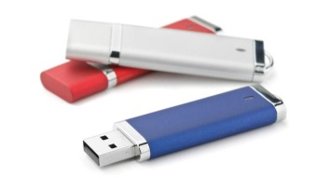
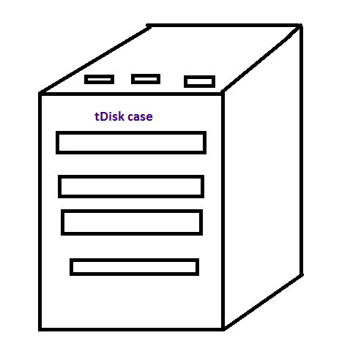
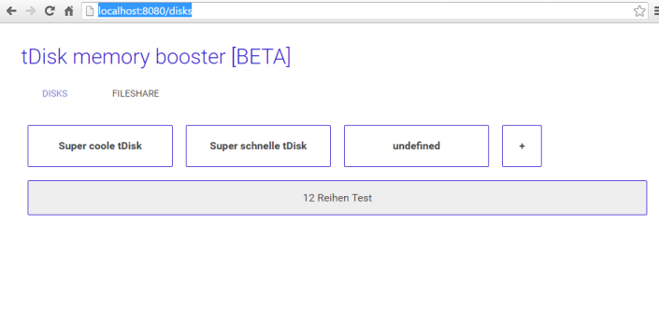

What

Slide 3
USP
Storage and „organized“ devices
Small sized USB, HDs, etc. combined generate applicable sized space
Modular concept, arbitrarily expandable
Memory boosting
Intelligent hardware driver continously optimizes access-speed
The more often a program is used, the faster it gets
Why? Different devices (SSD, SATA, etc.) have different read/write times – driver dynamically moves more used sectors to faster devices.
Include cloud storage, virtually endless storage available (no local storage needed) Cloud amazon
Cluster (old) server stacks?
Cheap storage!

Slide 4
Features
Responsive webinterface
Accessable from all devices (PC, Smartphone, etc.)
Raid stacks possible! (Redundant data storage)
Modular expandable
Accessable via LAN, WLAN (!), in progress: USB

Slide 5
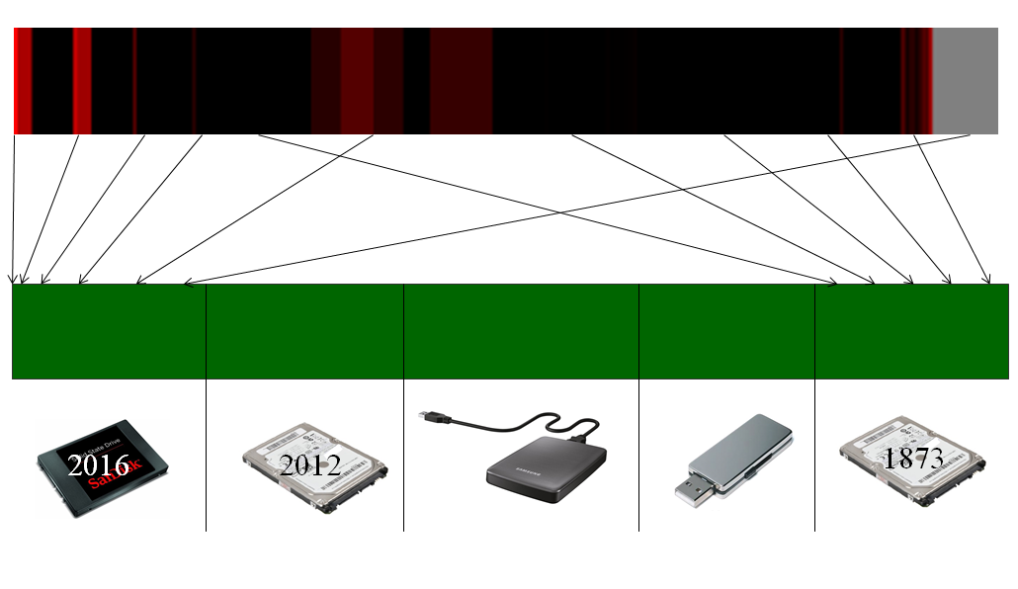
Technical details
Webinterface + server communication:
Angular 2 Framework, html + javascript based
Distribution among teammembers: GIT +
Hangouts
Driver:
Linux, platine

Slide 6
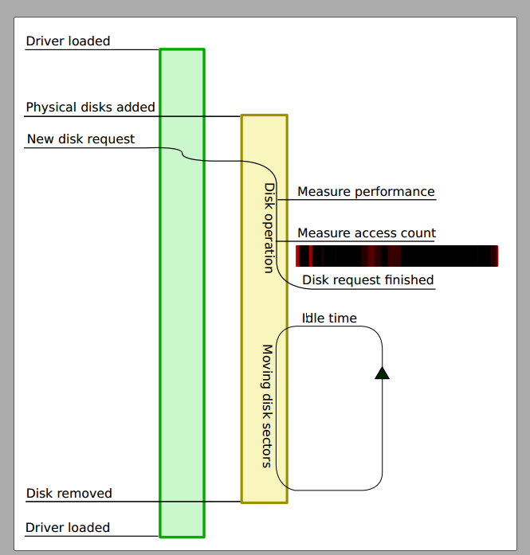
Technical details

Slide 7
Lean Startup

Slide 8
Economical Aspects
Platine – mass production?
Model?

Slide 9
Andy?
Optimieren nicht nur nach zugriffshäufigkeit,
Zb nach Dateigröße?
Funktioniert alles auch auf MAC, sogar Smartphones! (Samba Protokoll)

